Slide 1
Efficacy of Ventral Penile Reinforcement using a Pedicled Pericordal Fat Flap (CHARGE Technique)
Prior to Urethroplasty in Hypospadias
Developed by A. Yamataka in 2016
A. Yamataka (Yama)

Slide 2
Hypospadias
Hypospadias repair remains challenging, with a substantial risk of urethroplasty-related postoperative complications.
Urethrocutaneous Fistula
Urethral Stenosis

Slide 3
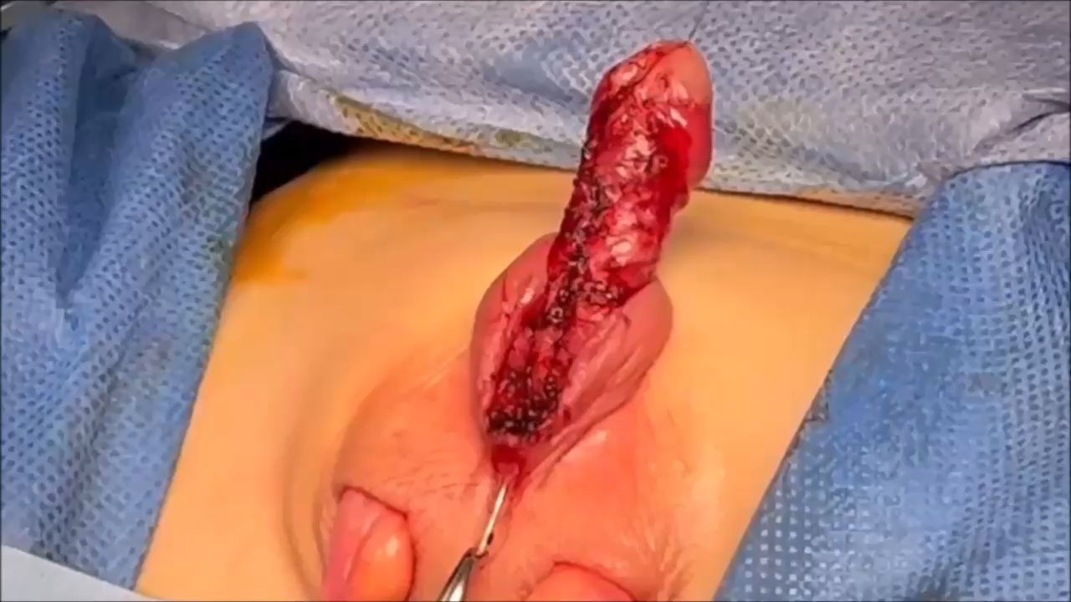
CHARGE Technique: Developed by Yamataka in 2016
In 2016, I developed the CHARGE technique. This technique reinforces the ventral penile shaft with a pedicled pericordal fat flap during initial surgery (degloving, fibrotic tissue excision, ±curvature correction) prior to urethroplasty.
Click to play the video.

Slide 4
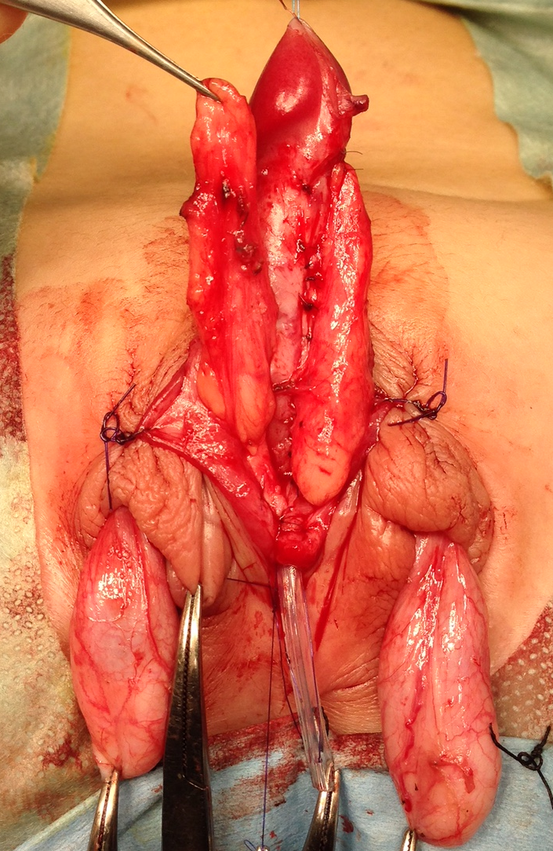
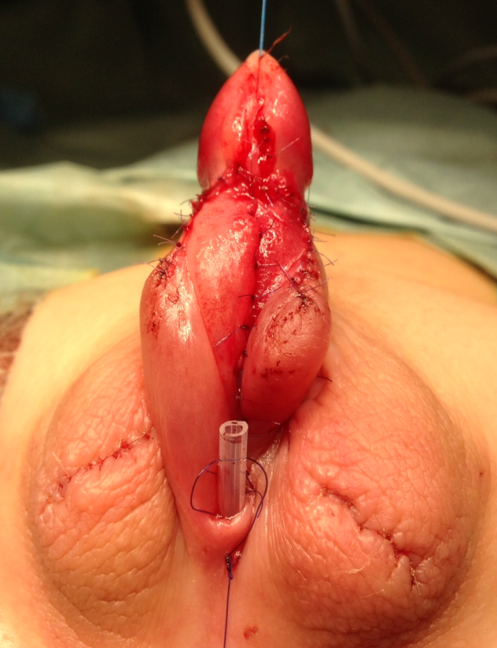
CHARGE technique
This approach substantially increases subcutaneous tissue volume and vascularity in the ventral foreskin prior to urethroplasty,

Slide 5
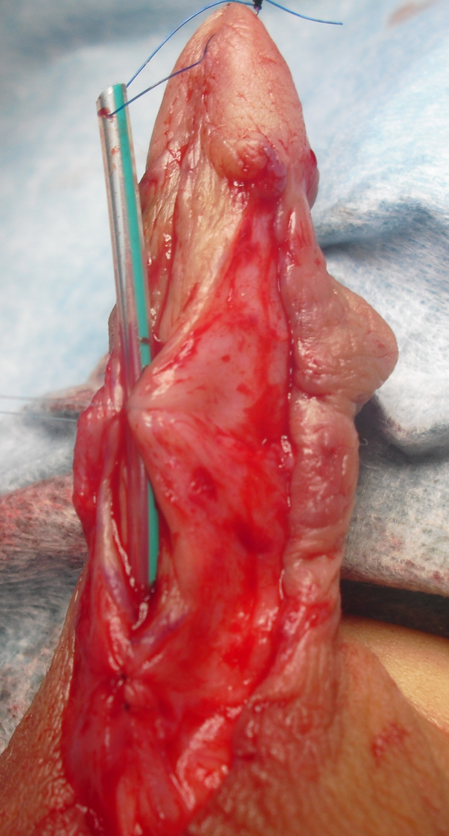
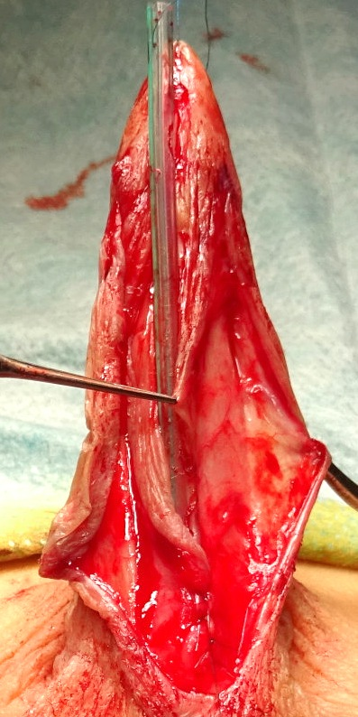
CHARGE technique
thereby facilitating urethroplasty and significantly reducing postoperative fistula and stenosis rates.
With CHARGE
Without CHARGE
Open arrowheads indicate markedly increased subcutaneous tissue volume.

